Slide 1
Asset Management in Action
A Real-World Story from the Mighty Waikato
2nd November 2023

Slide 2
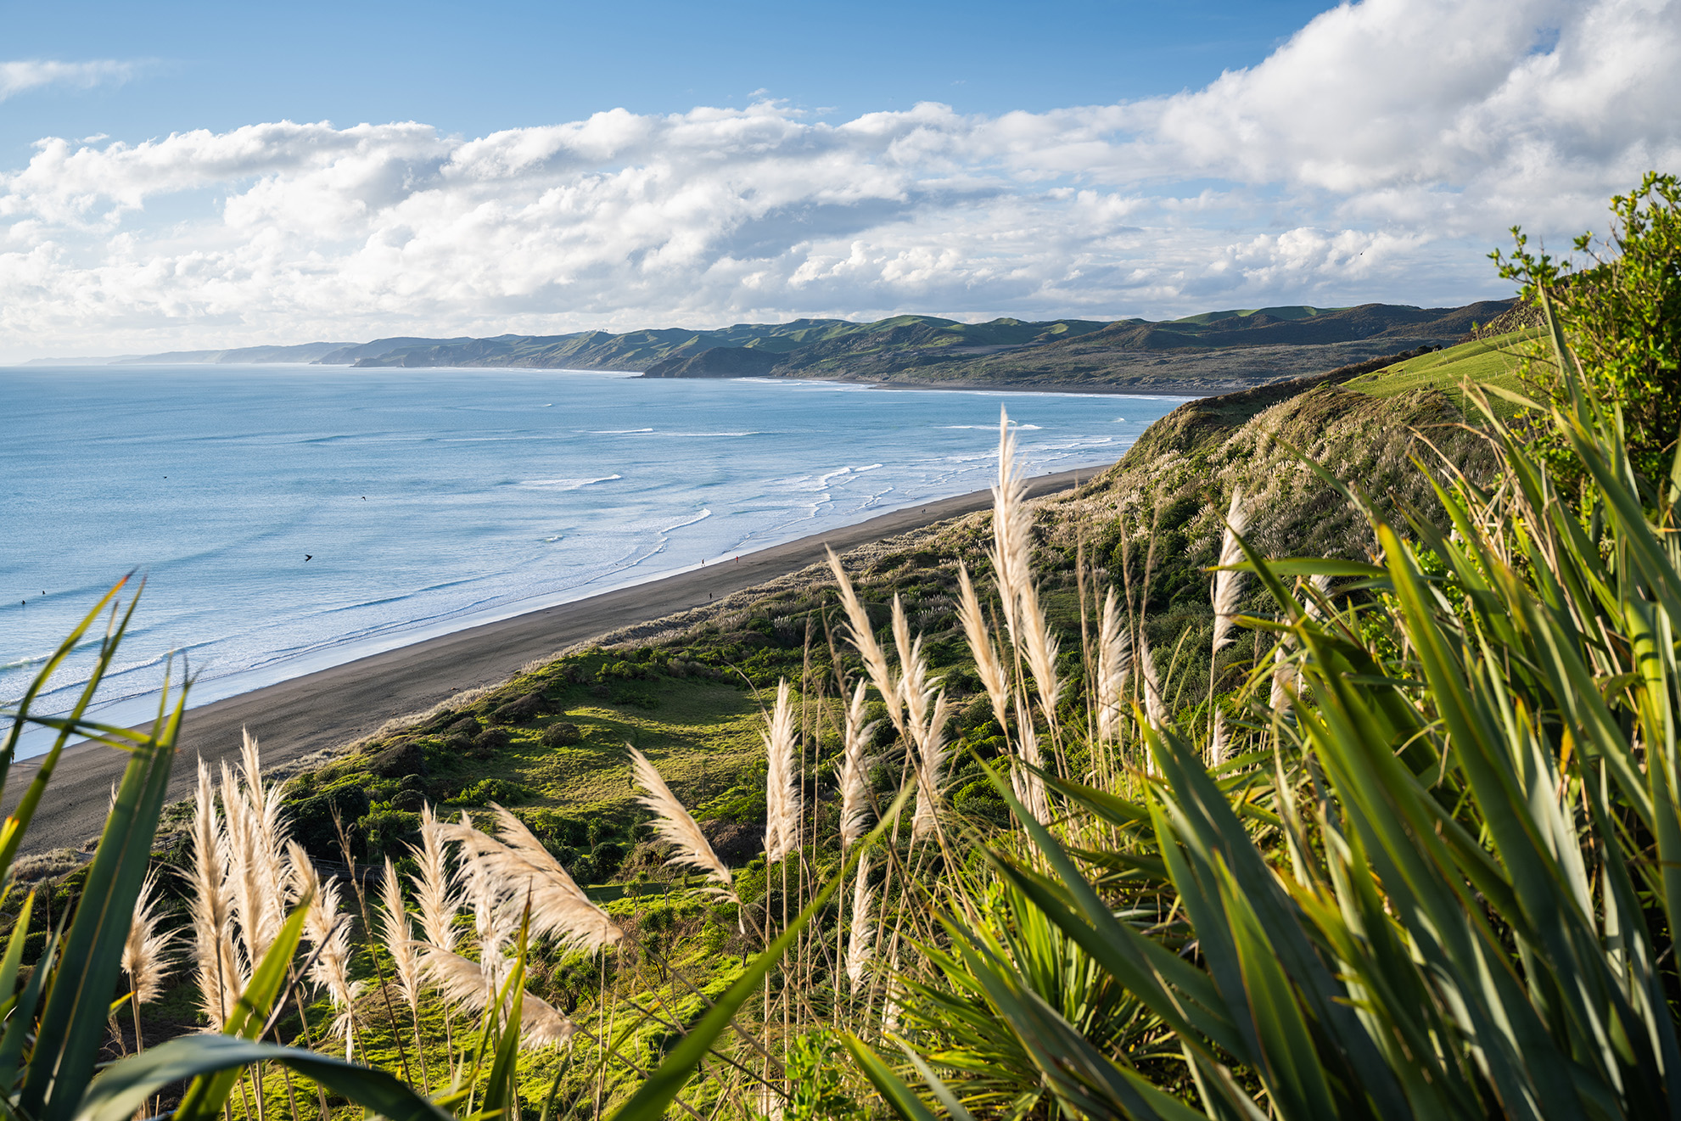


Previous Experience
Data Management
Strategic Property
Facilities Management
Notes:
Until approximately 8 years ago I had never heard or come across the area of asset management. I didn’t even know what it was. Never mind thinking that I could make a career out of it. While working in the UK for 4 years I dabbled into the area of data management. Including the Patient Safety Team at Great Ormond Street Hospital in London one of the key children’s hospitals in the United Kingdom. This provided me with the strong base of understanding on the importance of having high quality data. Because having the littlest thing wrong could have a dramatic impact on people’s / children’s lives.
Upon my return to NZ at the end of 2012 I floated around for just over a year or so before finding my first permanent job in over a decade. In 2014 I started as an administrator for the Strategic Property team at Hamilton City Council, providing me with my first ever insight into local government. It also provided me with the appreciation of the facets of strategic property and the important role they play within the local government setting. Not really acknowledging this importance and how they link to asset management until recently.
I stepped sideways into the Facilities Management team and then into asset management responsible for managing all the asset data relating to HCC’s building portfolio and helping activity owners develop their asset management plans (AMPs).
In June 2019 I took up a role as the Facilities Asset Engineer at Waikato DC. Where at the time there was only two of us in the asset management team. So with my data experience I took ownership of the asset management information system to wrangle the data into a usable state. (Which is an ongoing process still happening now) difference being is that we care for our data and want to ensure that it remains current and useful for everyone not just activity owners. “Taking Ownership”
In October 2022 I took over as the Community Assets Manager leading all things asset management within Waikato District Council. Also in late 2022 I was awarded the inaugural IPWEA (now Apopo) Priyani De Silva Currie Emerging Asset Management Scholarship, which gave me the opportunity to complete the Professional Certificate in Asset Management Planning and Integrating Asset Management and Governance qualifications. Which are the two compulsory pre-requistes into gaining the internationally recognised Certified Practitioner in Asset Management (CPAM) which I am currently in the application process of obtaining.
This is the background to how I ended up standing in front of you today, explaining Waikato DC’s asset management journey. As I go through the presentation you will learn where Waikato DC were, are presently and where we are heading. As with every journey it hasn’t been smooth sailing, with challenges and obstacles put in front of us. Which we have over come and continue to combat on a regular basis.

Slide 3
Where are we now?
Team of 6
2 x Roading Asset Engineers
2 x Facilities Asset Engineers
1 x Asset Information Officer
1 x Community Assets Manager
Notes:
During a restructure during 2019 it was identified that there was a gap in the asset management space, and that a dedicated team needed to be set up and established to provide an internal resource and focus on everything infrastructure asset management for Waikato DC. Which falls under the Service Delivery Directorate and currently reports directly to the Deputy GM. This has produced significant results which I will cover in more detail in a few more slides. Ultimately creating a centre of excellence.
But 4 years on we now have grown into the dedicated asset management team of 6, which I am the team manager, after the boss I had chosen had left (a week after I got from getting married!!). Managing and directing all facets of infrastructure asset management in the organization. It has taken 4 years to become a 100% fully resourced team, with our second roading asset engineer only coming aboard in mid September of this year. We were becoming the team that the ELT first envisaged when the concept of the Community Assets Team was conceived.
My original role was part of this restructure. On my arrival on my first day in June 2019, I discovered that I had no boss, and that there was only one other person in the team an Asset Information Officer. So ownership had to be taken, two months into the role I even had input into who my boss would be. My GM at the time admitted straight up that he knew nothing about asset management and that I was the expert and the reason he hired me. Definitely appreciated the honesty that the executive don’t know everything and are willing to admit it. Respecting my input and what I had to say.
Even to this day my current and previous general manager will always fight (when needed) on the importance of asset management around the executive table. As sometimes other members of the ELT need the reminder the importance of asset management and why the team was established in the first place. Which has been needed as activity planning has seemed to taken the limelight in current LTP planning process.
Before I go any further into our journey, lets have a quick AM101 session. So you can grasp a basic understanding of what and why we do what we do. Also why should you care about asset management.

Slide 4
What is Asset Management?
“The systematic and coordinated activities and practices of an organization to optimally and sustainably delivery on its objectives through the cost-effective lifecycle management of assets”
or
“Coordinated activity of an organization to realise value from assets.”
Its goal is to:
“ Deliver the required levels of service to existing and future customers in the most cost-effective way.”
Notes:
This is the formal definition of asset management which probably does mean much to you or makes much sense.
Evenly spread across generations, so tomorrow’s generation is not paying for the mistakes of today’s generation and vice versa.
But simply:
It is like caring for a house, or car, but only on a bigger scale. Think you own a home, you must maintain, repair, and potentially improve it over time.
But it is more than mending broken thinks. Planning is also important and a key aspect of what we do on a daily basis. We need to when we need an asset, how the asset is going to function (look like), where it is going to go, how much it is going to cost (including installation), ongoing operational and maintenance costs and ultimately when it will be disposed of and how much it will cost. (Commonly referred to as the lifecycle of an asset) – from cradle to grave. The whole picture.
Asset Management entails when predicting when a road will need repairs or replacement and allowing enough funding to pay for it. This way towns, and organisations can maintain their infrastructure and preventing it from deteriorating before it fails. We often to refer to it as “crystal ball gazing” and is not an 100% science.
Plan, maintain, and upgrade public facilities like
Roads,
Bridges,
Parks
Utilities, and
Buildings.
It optimises asset lifespan, performance, and cost-effectiveness while meeting community needs throughout time.
Asset management isn’t just about about writing asset management plans.

Slide 5
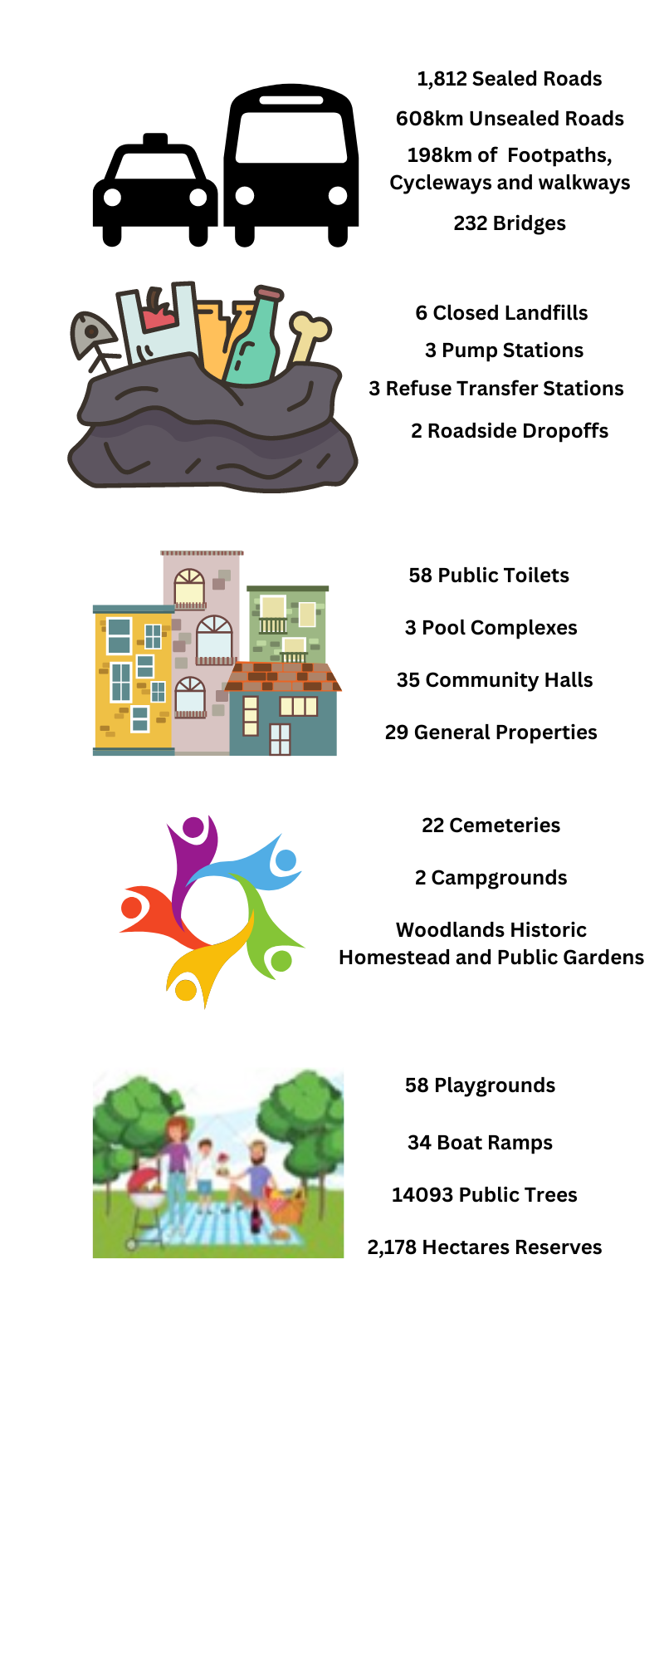
What assets do we look after
Notes:
There is a wide spread of infrastructure assets that we are responsible for looking after their management.
We have just over 2,400kms of roading network, which is longer than the entire state highway 1 network from the top of the North Island to the bottom of the South Island. Our unsealed network alone covers a distance equivalent covering from Auckland to Wellington 600kms.
Our asset portfolio is also quite varied:
Roading network, our network combined is longer than the entire State Highway 1 from top of the north island to the bottom of the south island and our unsealed network stretched out covers from Auckland to Wellington
Solid Waste covering closed landfills, refuse transfer station
Covering buildings including leased sites with various lease arrangements, Public Toilets, Pool Complexes
Cemeteries, Campgrounds, Heritage Site
Open spaces, Trees
Compared to our geographical size we do have a smaller asset portfolio (compared with other councils) with a value of $2.0 billion with approximately 90% sitting the Transport / Roading Space.
We are geographically spread covering more than 400,000 ha’s from Pookeno in the north down through to Raglan in the South and Tamahere and everything in between. With several key urban centres distributed predominantly within the Waikato River Corridor (with the exception of Raglan)
We are the largest district council in size in the North Island. We were formed in 1989 with the amalgamation of several small boards and boroughs coming together to form who we are today Waikato District Council. In 2008 the northern most part of the district was added through the splitting of Franklin DC in the Auckland Supercity Formation.
So as you can see we have and look after a wide variety of infrastructure assets. Which is definitely a juggling act at times considering they all require a variety of levels of service and differing useful lives.

Slide 6
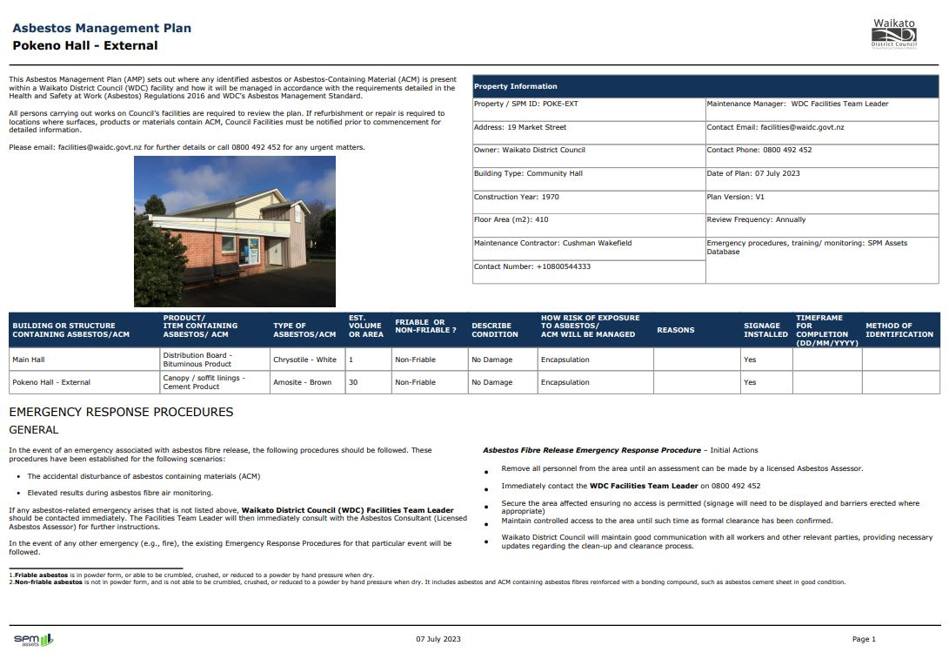
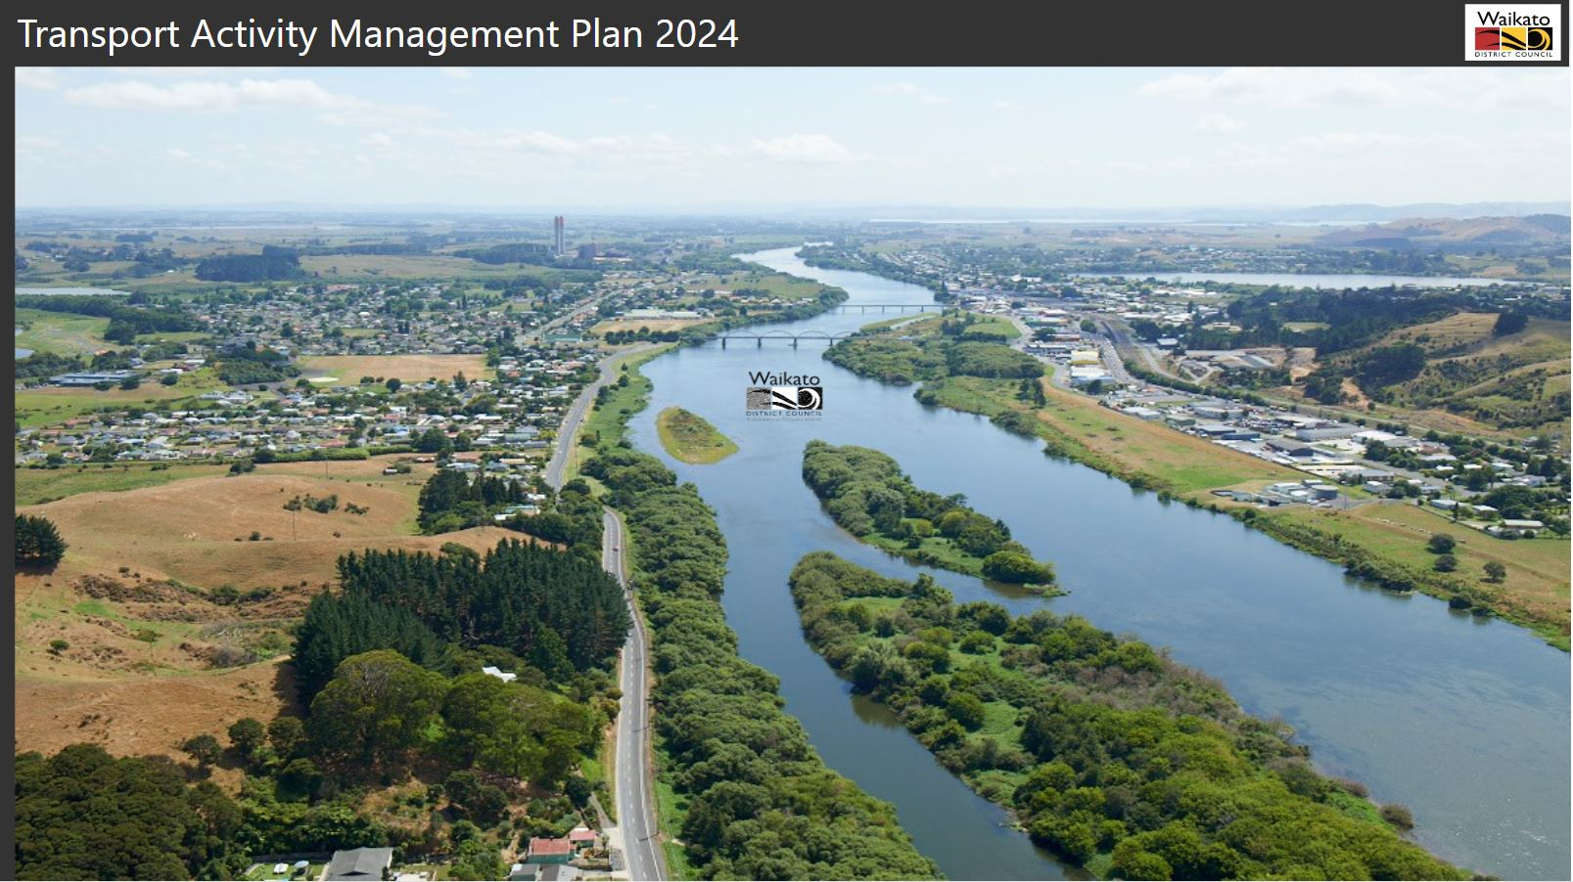
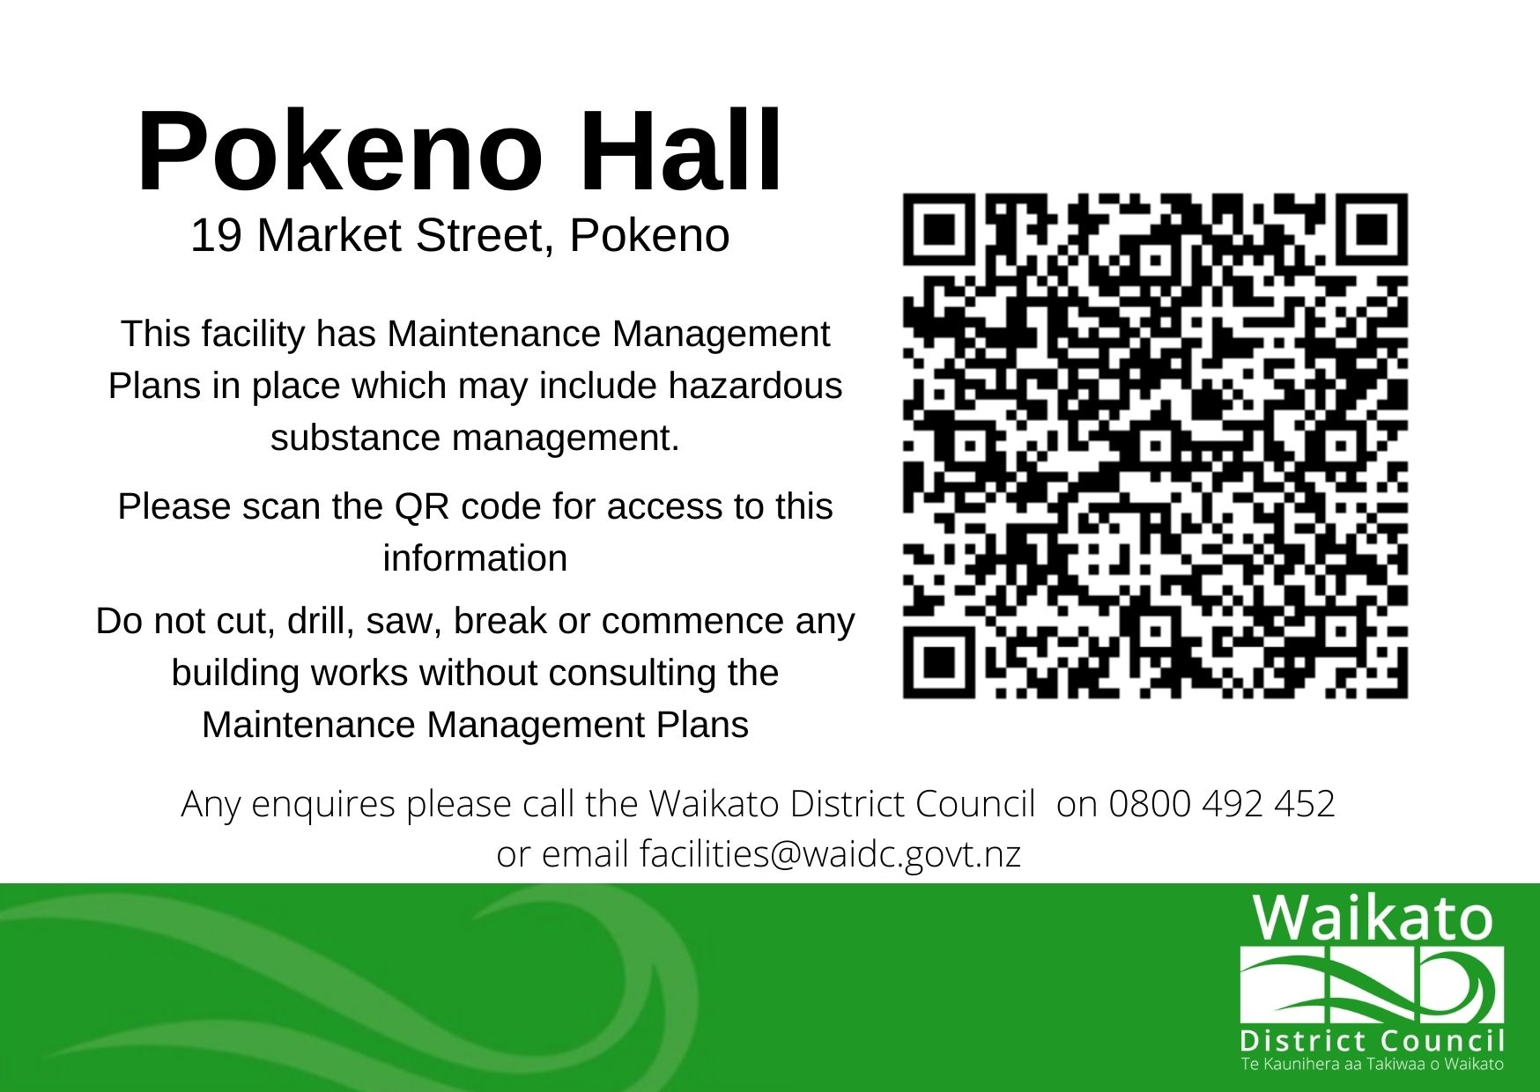
What have we achieved?
1st Digital Asset Management Plan
QR Coding for Asbestos and Emergency Evacuation Management
Development of an Asset Management Policy and Strategy
Increased read-only users for our AMIS systems
Asset Management Plans publicly available on our website
Asset management is in the limelight
Notes:
So within the last four years we have achieved several key things :
Digital AMP
We were the first council to publish our Transport AMP on a digital platform, instead of a over 700-page document that no one ever read.
People who normally didn’t read and Transport AMP (including myself) actually took interest
Visually Pleasing and Interactive
For the 2024 LTP we are looking at publishing the Asset Class AMP appendices for our other asset classes in a Power BI platform, with a view to publishing the entire suite of AMPs onto an electronic platform for the 2027 LTP.
Asbestos Management Planning
Bigger achievements
Asbestos has been identified as a critical safety risk for our organisation
SPM Assets our Community Asset AMIS System is the council’s organisational wide Asbestos Register and is the single source of truth for asbestos related componentry throughout our sites.
Zero Harm and SPM Asset Collaboration to develop Asbestos Management Plans for our sites was developed within our Community Asset Management Information System (SPM Assets)
One of my team members spoke with Christchurch City Council as they had seen QR codes on some of their buildings and thought it looked like a great idea. They then worked alongside our Zero Harm team to come up with the wording and the QR code design on the slide is the result. It is front-facing adhesive that is placed inside our buildings in a clearly visible space.
Anyone with a smart phone can scan and access the plan without having to login into the SPM Asset system, to ensure we met our legislative requirements of being readily available.
We have spoken with multiple other local authorities keen to implement something similar in utilising this technology.
Again leading the way.
The same technology is now being applied for Emergency Evacuation Management, all accessed using the same QR Code.
Emergency personnel will have access to all the building information at their fingertips.
Asset Management Policy and Strategy
Our AM Policy had been out of date for about 6 years and was developed prior to the Community Assets team coming together. So was no longer fit for purpose and didn’t accurately define our AM function and scope.
As part of the 2024 LTP planning cycle we have developed an Asset Management Strategy (or SAMP) which takes out all the generic duplicated information that appears in all the asset class AMPs into one place. Ultimately reducing the size of the Asset Class AMPs.
It describes our approach to asset management planning and is the first one that has ever been created at Waikato DC. We have a plan in place for it to be reviewed every 6 years in line with the LTP cycle, unless there has been any significant changed in legislation or growth assumptions.
Read-Only Users
We have 27 read only users, from 0 when I first started in the team. The entire Strategic Property, Facilities, Open Spaces and Reserve Planning Team have access along with a Risk Advisor and Zero Harm.
This has increased as we had improved the awareness of the importance of asset data, and how they can help themselves when there is an asset question to be resolved.
Asset Management Plans on Website
Before the 2021 AMPs none of the Waikato District Council AMPs were available publicly on the council website. But following some LGOIMA requests from other local authorities it became apparent that they should be publicly available. So in 2022 all the Infrastructure AMPs were published on the council website for the first time, and we are going to be publishing the 2024 AMPs following their approval in July 2024.
This has reduced the administration time in actioning and responding to a LGOIMA request.
Asset Management is in the limelight
No one knew what Asset Management was
But having a dedicated team focusing on asset management it has raised the awareness within the organisation, and highlighted the importance and how it links into many different areas of the organisation in different ways. It is an ongoing educational process throughout the organisation.
But in this time we have also undertaken:
Full Building condition survey over close to 200 buildings (which created its own challenges and improvements at the same time). As it ripped a band-aid off, forcing our facilities and strategic property team to define what we truly owned and what we were responsible for.
Ongoing data management, confirming ownership and working with asset owners
Contractors being our eyes and ears on the field, providing us with monthly asset data in a format that we can directly import into our AMIS, obviously following a quality check first
Building Asset Management Maturity

Slide 7
What challenges have we encountered?
Lack of buy in from the Executive Team (ELT)
Communication Breakdowns
Changing Environments (both economic and natural
Legislative
Resourcing
Processes
Notes:
But this hasn’t occurred without challenges along the way
Internal Messaging
Involvement of Contractors
Skill Sets
Clear understanding of what Asset Management is
Lack of buy in from the Executive Team (ELT)
Not taking into account the impact on asset management planning, with preparing non-asset related management (activity management planning) and any consequential impact
Communication breakdowns
Silos don’t work
Planning teams not realising impact of decisions on asset team ie strategies, growth numbers
Asset Management is a team effort.
Changing Environments (both economic and natural)
This year has been challenging because of the different weather events putting strains on budgets and resource

Slide 8


Legislation Reform
Three Waters Reform
Local Government Reform
Resource Management Act
Notes:
Three Waters taking a lot of oxygen at the moment – need to adjust the focus to community based assets, ie Open Spaces and Buildings
Local Government Reform what does that mean for local government and what are its impacts?
With the result of the recent election we don’t know what changes that is going to cause, so it does create a uncertain and unstable time for local government and how we plan for our assets moving forward. Moving goal posts definitely makes it harder. We will just have to wait and see and make the most out of the situation.

Slide 9
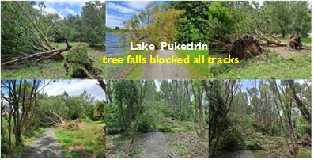
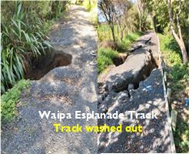
Natural Hazards and Climate Change
Notes:
All the weather events that we have experienced this year, has really impacted different parts of our district in different way.
As you can see in the pictures for Port Waikato, the ocean had taken away significant portion of the coastline
Port Waikato
- In the past 3 years we have had to:
- Move the lifesaving club tower
- Demolish the community hall
- Have lost a significant portion of the carpark.

Slide 10
But why should you care?
What we need to know from you
Do we own a property?
What are our lease or tenancy obligations?
What leases are in place?
What property are we planning on selling or assets we are going to demolish?
What you need from use
How much are ongoing renewal and maintenance costs on the property?
Is the property insured?
What property do we need and where / when do you need it?
Notes:
It wasn’t until I started working at Waikato DC that I saw the important part that Strategic Property plays in ensuring successful asset management.
There is an important overlap between property managers and asset managers
Why it Matters
Where in my opinion it differs and why one is connected with the other
These are all questions that only Strategic Property has the answers to, but it isn’t just a one-way street.

Slide 11

Keeping it Practical – Practical Tips
Communication
Storytelling - Telling a good story
Collaboration – Working Together
Notes:
Communication – As with everything, communication is key, we can’t keep working in our silos we need to communicate with each other. It whatever form works. Both internally and externally, as our external stakeholders like our contractors all have their part to play in the asset management cycle.
Telling a good story and customising it to the audience you want to get the message across to is key. If you get your story right and tell it in a way that people can understand you will not fail. A story can change based on the person the story is being told to (customisation). You won’t get it right first time, but customising your messages and adjusting the mediums it is told in you will get it right and you will get your message across. As the old saying goes, practice makes perfect.
Collaboration – Working Together – Asset Management is a team effort, it isn’t just the Community Assets / Asset Management’s team responsibility to educate and enhance understanding. Everyone within an organisation needs to get behind it, ranging from the Elected Members, Executive, Strategic Planners, Strategic Property through to Asset Owners. It touches every part of an organisation in some form, so everyone needs to get behind it and understand it. Without that it will fail.

Slide 12

Where to from here?
Digital AMP Development
Emergency Response Plans
Data Improvements
Increasing Awareness
Notes:
Bringing the entire suite of Asset Management Plans into the digital space, including potential our infrastructure and financial strategies into the digital space.
There was one item I missed off here before submitting this presentation – The development of an Asset Management Steering Group – to continue to raise the awareness and push the importance of asset management within the organisation, it will involve a spread of key stakeholders across the organisation. And assist the Community Assets (centre of excellence) to become a high performing team and take us to the next level.

Slide 13
Waikato District Council
Thank you

